Slide 1
Closing gender pay gaps
Guide for leadership, transparency
and employer action

Slide 2
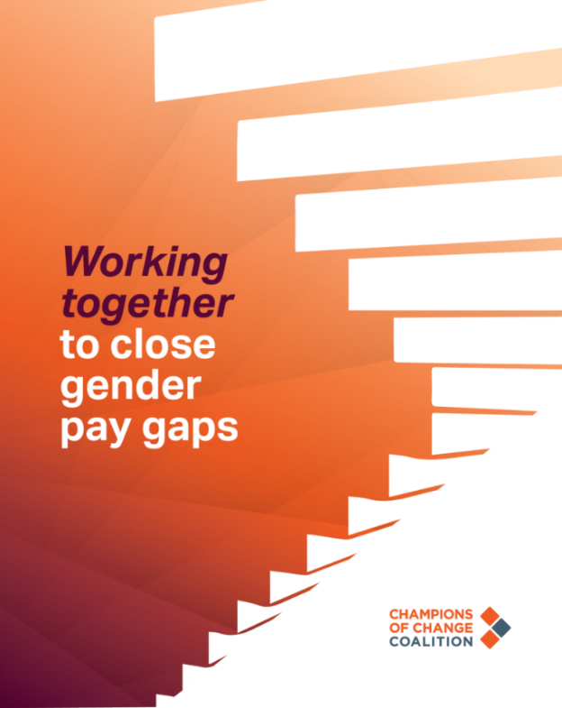
About this resource
The Workplace Gender Equality Agency (WGEA) has been publishing employer gender pay gaps since February 2024. This resource aims to help ensure organisations are ready for WGEA’s private sector data release on 4 March 2025 and Commonwealth public sector data release later in 2025.
Developed by Champions of Change Coalition, this resource is designed to support well-informed conversations between organisations and stakeholders regarding employer gender pay gaps. It can help organisations focus the discussion on the key drivers of gender pay gaps; steps taken to address them at an organisation, industry and national level; and future priorities for action
It covers:
    Understanding gender pay gaps
    The drivers of employer gender pay gaps and focus areas for change at organisation, sector and national levels
    Details of collective action Champions of Change Coalition has taken to advance gender equality at organisation, sector and national levels, which helps to close gender pay gaps
    Elements that will be important for organisations to understand and address when communicating their employer gender pay gaps in 2025, including key changes from the previous year.
    Templates to help organisations: articulate their commitment to closing gender pay gaps; understand their data; compare progress to peers; identify priority areas, develop action plans and communicate about gender pay gaps with their stakeholders.
More information, including case studies/examples of Member action to close gender pay gaps and additional resources can be found on the Champions of Change Coalition website Working together to close gender pay gaps - Champions Of Change Coalition.

Slide 3

Understanding gender pay gaps
National, sector-based and employer gender pay gaps
provide powerful, aggregate measures of progress
towards – and critical insights to inform – strategies
for advancing gender equality in the workplace.
Analysing gender pay gap data is useful for tracking and encouraging employer, industry and societal action on gender equality. It shows how organisations and industries are progressing towards pay equality, and how well they do in attracting, retaining and advancing women at all job levels – including into positions that are high-paid, higher profile and that attract higher economic value.
By collecting, analysing and reporting data on gender pay gaps we can understand organisations’ and industries’ level of commitment to achieving gender equality when it comes to job opportunities, progression and pay.
This analysis also prompts a more in-depth consideration of the gender stereotypes and norms that influence education, career pathways, caring roles and, importantly, the historical under-valuation of traditionally feminised roles and sectors.
While related, pay equality and gender pay gaps are two different aspects of compensation disparity. Pay equality is more about individual disparities, while gender pay gaps represent disparities across cohorts. Analysing data on average and median gender pay gaps, and their distribution across entire industries and nations, helps to identify the systemic causes of the gaps. These causes include the low representation of women in leadership or traditionally male-dominated roles, which cannot be fixed with individual corrective salary adjustments alone.
New standards for disclosure are in place and employers
have access to more detailed data on pay gaps.
Amendments to the Workplace Gender Equality Act 2012 passed by Federal Parliament in March 2023 created new standards for reporting and disclosure of employer gender pay gaps for the Australian workforce.
These reforms aim to improve transparency, accountability and motivate action to accelerate progress on gender equality in workplaces.
From March 2025 annual public reporting of employer gender pay gap data includes average gender pay gaps by total remuneration and base salary, median gender pay gaps by total remuneration and base salary, gender composition by quartile and average remuneration by quartile.
Applying different 'lenses' to the review of employer gender pay gaps enables deeper analysis and offers new insight to guide meaningful action.
For further information on WGEA's methodology for calculating gender pay gaps refer to wgea.gov.au.

Slide 4

Understanding gender pay gaps
Materially and sustainably closing gender pay gaps requires
actions at organisational, industry and societal levels – such as those undertaken through the Champions of Change strategy.
Champions of Change Coalition Member efforts at an organisational level include actions such as implementing remuneration policies that proactively address gender pay disparities, supporting 40:40:20 gender representation goals in recruitment and promotion processes, providing sponsorship to elevate the next generation of women leaders, addressing the under- or over-representation of women in certain job families or functions, and building safe and inclusive workplaces for all people.
Beyond these organisational actions, the Coalition engages in whole-of-industry efforts to drive inclusive gender equality, and to address the societal structural inequalities, gender norms, stereotypes and beliefs that:
    underpin children and young people’s educational interests and preferences
    channel men and women into certain roles, occupations and industries
    perpetuate the gendered division of household management and caring
    inequitably pay and/or reward roles or occupations historically dominated by women.
To achieve sustainable societal change, employer actions will need to be complemented by the everyday actions of teachers, career influencers,
the broader education sector, parents, carers and families.
Applying a range of different lenses can help
organisations to more deeply understand the
drivers of gender pay gaps.
Reviewing gender pay gaps through, average, median and quartile analysis provides a comprehensive and more granular insight into the distribution of earnings. It also helps identify the causes of and potential solutions for gender pay gaps. Organisations can use these insights to help track progress on gender equality and identify the most targeted and effective opportunities for improvement.
The gender pay gap can be wider for women who experience other forms of discrimination, such as First Nations women, LBTQ+ and culturally and racially marginalised women and women with disability. Many Members capture this data at an organisation level as part of their analysis to understand the full extent of pay disparities in Australia.

Slide 5

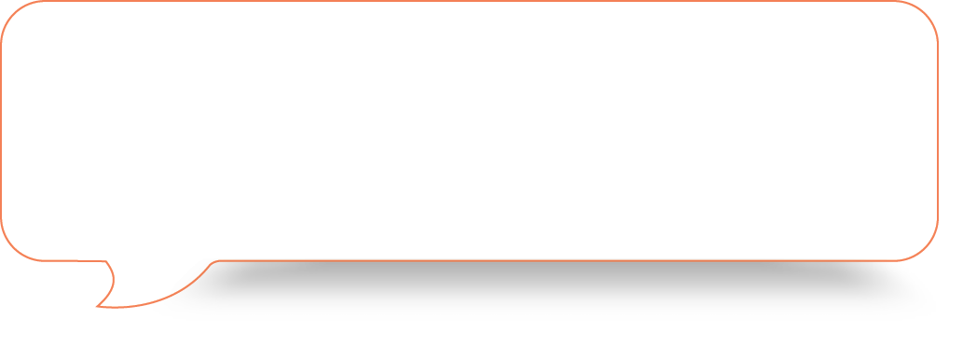


Understanding gender pay gaps
WGEA reporting IS NOT about like-for-like pay gaps
Gender pay gaps are not the same as pay inequality or like-for-like
pay gaps. Pay inequality is where women and men are paid different amounts for performing the same role or different work of equal or comparable value. In Australia, paying men and women equally for performing the same roles has been a legal requirement since 1969.
WGEA is reporting on employer gender pay gaps
Employer gender pay gaps reflect the overall uneven distribution of salaries in an organisation. Analysis of employer gender pay gap data can show whether certain groups or demographics are disproportionately represented in different job categories or levels. By evaluating the pay gaps, organisations can gain insights into potential systemic issues related to workforce equity. Gender pay gap data is therefore a key tool for assessing overall progress on gender equality and pay equality in the workplace.
    Important note from WGEA:
    Recognising that gender is a social and cultural concept, since the 2020-21 reporting period, WGEA has created the option for employers to report employee gender as non-binary as a voluntary data category. Although the proportion of non-binary employees in WGEA's dataset has increased, the number of nonbinary employees remain small and reporting is voluntary so it cannot be analysed for the purposes of gender pay gaps. Recommendation 7.2 of the Review of the Workplace Gender Equality Act (the Review) recommended legislative changes to enable WGEA to collect data on nonbinary employees. WGEA has recently conducted consultations on this recommendation.

Slide 6
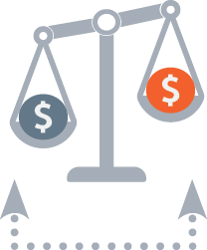


Understanding gender pay gaps
From 2025, WGEA is reporting on average gender pay gaps, median gender pay gaps, gender composition and average total remuneration by pay quartile.
Average gender pay gaps
The average pay in an organisation is calculated
by dividing total employee earnings by the
number of employees in the cohort. To establish the gender pay gap in the organisation, the same calculation is done for women and for men. That is,
the total earnings of women is divided by the number of women in the cohort, and the total earnings of men is divided by the number of men.
A comparison of the two resulting figures will provide a high-level overview of the disparity in earnings between men and women. These calculations enable benchmarking against industry and national averages. This data point is sensitive to extreme values, such as very high or very low salaries, and may be influenced by the distribution of employees across different pay levels, roles, or seniority levels within the organisation.
Median gender pay gaps
The median or midpoint is the middle value when all values are arranged in ascending or descending order. If there is an even number of values, the median is the average of the two middle values.
In the context of gender pay gap analysis, the median compares the earnings of the middle-ranking man to the middle-ranking woman.
Unlike the average, the median gender pay gap calculation is less influenced by extreme values, making it a more reliable measure of typical earnings. It highlights structural disparities by identifying the midpoint of the pay distribution and can reveal concentrations of one gender in lower-paying roles.
Quartiles
Quartile analysis of an organisation’s gender pay data separates employees into four equal groups (quartiles) based on compensation, with the first quartile being the highest earning group and the fourth quartile the lowest.
In the context of gender pay gaps, organisational gender composition and average total remuneration by quartile highlights disparities in gender representation and compensation, which are key drivers of gender pay gaps.
Calculating gender composition and average total remuneration by quartile offers a segmented view of the workforce. It therefore provides more granular insights into whether representation and compensation disparities at particular salary ranges, between roles and departments and job levels, are driving gender pay gaps.
Remuneration for CEO or equivalent, Heads of Business and casually employed managers has been included in private sector gender pay gap public reporting from 2025, so direct comparisons between data released in Feb 2024 and March 2025 are not possible.

Slide 8







Understanding, communicating and taking action to close gender pay gaps
The following pages contain templates to help organisations analyse their gender pay gaps, develop and communicate their action plans to close them. The templates cover the following seven elements:
1
2
3
4
5
6
7
Statement of commitment
Context
Data overview
and analysis
Industry, sector and national comparisons
Key drivers for gender pay gaps in your organisation
Actions and impact to date
Priority focus areas and plans
    Overall employer commitment to gender equality and closing the gender pay gaps e.g. through engagement/
    participation in Champions of Change
    Stakeholder engagement to build awareness, understanding and commitment
    Workforce coverage
    Workforce exclusions
    e.g. partnership models
    Data inclusions/ exclusions e.g. base salary/ bonus
    Business entities reported on
    Gender pay gap analysis
    Snapshot of your organisation data per the WGEA framework
    Insights including directional trends of data each year
    Note changes to scope or reporting i.e. inclusion of CEO remuneration data for the first time meaning direct comparisons year-on-year are not possible
    Gender pay gaps from broader industry/sector context
    Directional
    trends for your industry/sector
    How your organisation compares to industry/sector and national pay gaps
    Drivers of the gender pay gaps in the context of your organisation
    Include drivers
    at all levels, including:
      organisation
      industry/sector
      national/societal
    Actions taken to reduce the gender pay gaps
    Impact of actions (ie. how have the actions changed your data)
    Include actions
    at all levels, including:
      organisation
      industry/sector
      national/societal
    Outline your credible plan
    to reduce your gender pay gaps
    Include specific actions and targets
    Include plans at all levels, including:
      organisation
      industry
      national/societal

Slide 9








1. Statement of commitment
Industry
Organisation context
Why this is important for your organisation
Commitment
Priority focus areas
Guidance note: This is your ANZSIC industry class or industry division, as listed in the WGEA Reporting Industry Benchmark Report.
Guidance note: Provide contextual information such as type, structure, whether it is traditionally male-dominated and other relevant details. If the statement is for a single employer, organisation size is listed as ‘employee range’ in the employer level WGEA Reporting Industry Benchmark Report. If the statement is for a Corporate Group, you can include the number of employers in the group and the overall employee size as listed in the WGEA Reporting: Corporate Group Executive Summary.
Note that the scope of reporting has changed to include remuneration for CEO or equivalent, Heads of Business and casually employed managers, meaning direct comparisons between gender pay gaps reported in Feb 2024 and Feb 2025 are not possible.
Guidance note: Articulate why closing the gender pay gaps is important for your organisation’s gender equality, commercial and cultural goals. For example: “We are committed to achieving gender equality and have a significant role to play. Half a trillion dollars will be invested in our sector over the next decade. We want to tap into all the available talent to achieve our goals and ensure that women can equally access and benefit from this significant economic opportunity.”
Guidance note: Describe your organisational commitment to gender equality and closing gender pay gaps, including internal or public targets and specific areas of focus (e.g. getting women into leadership, specific roles or occupations where they may be under-represented.) and action taken over the reporting period.
Guidance note: Summarise key data points, themes and drivers of your gender pay gaps, including the overall pay gap percentage and any significant patterns or trends identified (e.g. like-for-like pa, occupational segregation, hierarchical segregation, industry segregation, gender bias).
Considerations:
    If your organisation reports as a Corporate Group, you can develop a statement for each ‘relevant employer’ or a single statement for the whole group.
    It is important to have clear messaging around commitments, why this matters for your organisation, and the priority focus areas for your organisation.

Slide 10
Stakeholder engagement
Below is an outline of key organisation stakeholders and the role they can play to help understand gender pay gap data, develop action plans and prepare internal and external communications.
Stakeholder | Action
Board; people committee; remuneration committee; ESG/sustainability committee | WGEA legislation requires WGEA Executive Summary and Industry Benchmark Reports for employer and Corporate Group levels be shared with your governing body (e.g.Board). Employers with 500 or more employees must have a policy or strategy which covers each of the six Gender Equality Indicators. Review organisation data, discuss key drivers, outcomes of action taken, actions underway and plans to close the gaps.
CEO | Be aware of your employer gender pay gaps and related workforce data, ensuring you are across key WGEA reports including Executive Summary, Industry Benchmark report and Corporate Group Executive Summary (if relevant), including changes to benchmarks arising from the inclusion of CEO remuneration in gender pay gap data to be reported in March 2025. Articulate the drivers of gender pay gaps as well as outcomes of action you have taken and a credible plan to reduce them. Clearly communicate the difference between 1) like-for-like pay/pay equality and the gender pay gap and 2) average and median gender pay gap values – an ongoing task for leaders. Review and sign off your Employer Statement which can be linked to WGEA’s website to give context to your gender pay gap data and the strategy you have underway to close it.
Head of People and Culture; head of Diversity, Equity and Inclusion; head of Remuneration and Benefits; data analytics team | Assist CEO, executive leadership team and board in understanding your obligations, data, the drivers of the employer gender pay gaps, outcomes of actions taken and strategies in place to close them. Share gender pay gap data across your organisation to ensure employees understand your data and your commitment to transparency and action to close gender pay gaps.
Executive leadership team | Clearly articulate the gender pay gaps (including the distinction between like-for-like pay and your employer gender pay gaps), drivers, actions taken and your credible plan to close these gaps for teams and other stakeholders. This includes the whole organisation or specific divisions, especially if there are ‘toughspots’.
Remuneration, recruitment, development and line managers | Support data collection, analysis and reporting in line with the WGEA standards. Support efforts to explain the data to current and potential employees, including the distinctions between like-for-like pay and employer gender pay gaps, average and median gender pay gap values, total remuneration and base salary, to address misconceptions about gender pay inequality for comparable roles.
Head of Corporate Affairs/Communication; head of ESG/Sustainability; head of Investor Relations; head of Marketing | Recognise that gender pay gaps are likely to become a key measure of social impact performance (the ‘S’ in ESG). Prepare relevant internal and external communications relating to the data (e.g. annual reports, investor briefings, website). Clearly articulate the gender pay gaps, drivers, actions taken and your credible plan to close gaps.

Slide 11
2. Context
Including context or background will be helpful for stakeholders to understand your data set or any limitations of the data.
Workforce coverage
Gender pay gap analysis
Other | Guidance note: Include any other context or background that will be helpful for stakeholders to understand your data set or any limitations of the data.
Guidance note: Include details of workforce coverage (e.g. partnership models), data inclusions and exclusions (e.g. base salary, bonus) and business entities reported on.
Guidance note: Summarise how analysis was undertaken to determine the key factors driving gender pay gaps and where to focus actions to optimise progress. Include data sources, calculations, any limitations or assumptions made.
For example:
Gathered comprehensive pay data for all employees, including their gender, job roles and compensation – including CEO remuneration for the first time.
Considered variables by gender such as job roles, levels, seniority, experience, education and tenure.
Reviewed additional elements such as bonuses, incentives, benefits and allowances.
Compared pay gaps across job levels and functions.
Compared the organisation's gender pay gaps with industry benchmarks and similar organisations.
Reviewed surveys, focus groups or interviews with employees, to gain insights into their perceptions and experiences regarding pay and opportunities for career advancement.
Conducted root-cause analysis to identify systemic issues, biases in recruitment and promotion processes, and barriers to career progression for women. This included considering factors such as occupational segregation, unconscious bias and lack of flexible work options.
Comparison of 2022-23 and 2023-24 median pay gap data and evaluating outcomes of actions taken.

Slide 12
3. Data overview and analysis
3.1 Data summary
Average total remuneration | 2017–18 | 2018–19 | 2019–20 | 2020–21 | 2021–22 | 2022–23 | 2023-24
Organisation | <Insert> | <Insert> | <Insert> | <Insert> | <Insert> | <Insert> | <Insert>
Industry/Industry Comparison Group | <Insert> | <Insert> | <Insert> | <Insert> | <Insert> | <Insert> | <Insert>
National | <Insert> | <Insert> | <Insert> | <Insert> | <Insert> | <Insert> | <Insert>
Median total remuneration | 2017–18 | 2018–19 | 2019–20 | 2020–21 | 2021–22 | 2022–23 | 2023-24
Organisation | <Insert> | <Insert> | <Insert> | <Insert> | <Insert> | <Insert> | <Insert>
Industry/Industry Comparison Group | <Insert> | <Insert> | <Insert> | <Insert> | <Insert> | <Insert> | <Insert>
National | <Insert> | <Insert> | <Insert> | <Insert> | <Insert> | <Insert> | <Insert>
Considerations:
    There are many ways to analyse gender pay gaps, and ultimately each organisation can determine, in addition to the mandatory measures from WGEA, what additional analysis will be included.
    If you have multiple relevant employers within a Corporate Group, consider how you will report and analyse this data. Industry comparisons may not be available for Corporate Group level data given the limited number of comparable organisations.
    Gender pay gaps will likely fluctuate year-on-year initially, with an overall downward trajectory as we better understand and address the drivers of gender pay gaps and new reporting standards are rolled out.
    CEO remuneration is included in the calculation of 2023-24 gender pay gaps. As a result, employer average gender pay gaps might be contrary to the downward trend. If the median gender pay gaps still show a trend of improvement, the difference in average could be attributed to this new data inclusion as averages are susceptible to outlier values.
Average base salary | 2017–18 | 2018–19 | 2019–20 | 2020–21 | 2021–22 | 2022–23 | 2023-24
Organisation | <Insert> | <Insert> | <Insert> | <Insert> | <Insert> | <Insert> | <Insert>
Industry Comparison Group | <Insert> | <Insert> | <Insert> | <Insert> | <Insert> | <Insert> | <Insert>
National | <Insert> | <Insert> | <Insert> | <Insert> | <Insert> | <Insert> | <Insert>
Median base salary | 2017–18 | 2018–19 | 2019–20 | 2020–21 | 2021–22 | 2022–23 | 2023-24
Organisation | <Insert> | <Insert> | <Insert> | <Insert> | <Insert> | <Insert> | <Insert>
Industry Comparison Group | <Insert> | <Insert> | <Insert> | <Insert> | <Insert> | <Insert> | <Insert>
National | <Insert> | <Insert> | <Insert> | <Insert> | <Insert> | <Insert> | <Insert>

Slide 13
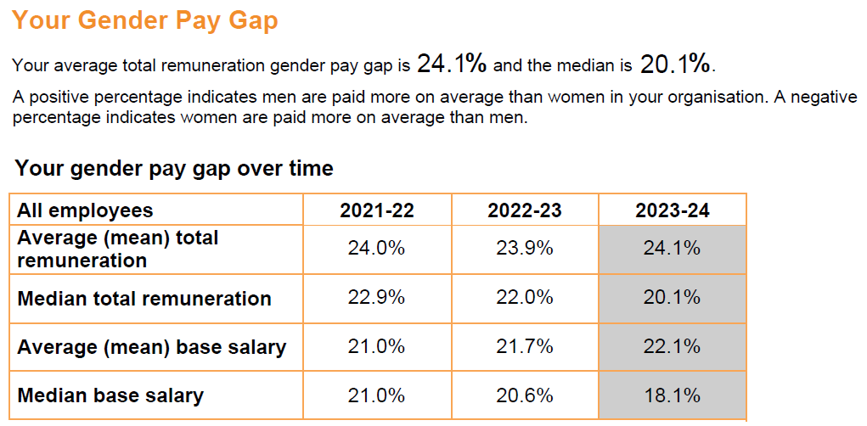
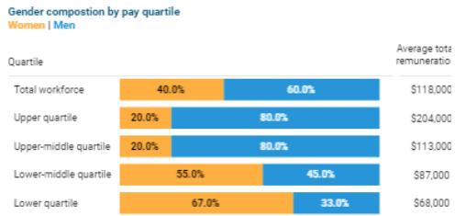
3. Data overview and analysis
3.2 Data presentation
3.2 About our data
Guidance note: This is an opportunity to provide explanatory detail, e.g. "Our gender pay gaps have declined over the last three years. Our gender representation by remuneration quartiles indicates there are proportionally more women in the bottom two quartiles, which is a key driver of our gender pay gaps. “
Considerations:
    It is recommended to present data in charts rather than tables to illustrate data trends more effectively.
    WGEA is publishing average gender pay gaps for the first time in 2025. A large difference between 2022-23 and 2023-24 average gender pay gaps could be due to the fact that CEO remuneration is included in gender pay gap calculations for the first time.
Mandatory public reporting for 2025
SAMPLE DATA
SAMPLE DATA
Shaded numbers represent the Gender Pay Gaps that will be published
Adapted from Understanding and using your WGEA reports for 2023-24 , WGEA.

Slide 14
3. Data overview and analysis
3.3 A deeper dive into gender pay gap data
A deeper dive into gender pay gap data or more granular analysis of gender pay gaps will inform more targeted strategies for functional areas or employe cohorts where gender pay gaps may be exacerbated.
Additional information (if available in your organisation) | 2017–18 | 2018–19 | 2019–20 | 2020–21 | 2021–22 | 2022–23 | 2023-24
Functional compared to operational/line gender pay gap (Average as collated by organisation) | <Insert> | <Insert> | <Insert> | <Insert> | <Insert> | <Insert> | <Insert>
Specific gender pay gap areas of interest for your organisation e.g. Job level; department/division; intersectional elements such as by age range; tenure; ethnicity/culturally and racially marginalised identity; LBTQ+ identity; disability. | <Insert> | <Insert> | <Insert> | <Insert> | <Insert> | <Insert> | <Insert>
3.3 About our data
Considerations:
    Demographic data analysis will be limited by what data each organisation collects. Collecting broader data is a great way to understand how intersecting inequalities may impact organisational gender pay gaps.
    Although additional levels of data are not currently part of the WGEA reporting requirements, you may wish to include any data your organisation has collected to create an expanded picture of your gender pay gaps.
Guidance note: This is an opportunity to provide explanatory detail, e.g. “We have proportionally more women working in functional roles than in operational/line roles, which is contributing to our gender pay gaps. We have been voluntarily publishing our ethnicity pay gap for two years. Our mean ethnicity pay gap is -0.3%, which is an improvement of five points on the previous year.”

Slide 15
4. Industry, sector and national comparisons
Key change for 2025 public reporting:
    There are changes to the calculation of benchmarks for the 2025 data release. These benchmarks have already been provided to private sector employers in the Industry Benchmark Report which was distributed to organisations in November 2024. The industry benchmark provided for each gender pay gap is established by identifying the midpoint of all employer gender pay gaps in each comparison group - essentially the ‘midpoint of the medians’ of all employers in a comparison group or the ‘mid point of the averages’ of all employers in a comparison group.
Industry insights
National and societal insights
Other
Guidance note: Use the following questions as a guide for understanding how your organisation’s data compares to industry data as an indicative benchmark of relative progress:
What are the gender pay gaps for your industry?
What is the trend over the last 3-5 years?
How does your organisation compare to the industry data?
What factors contribute to your employer gender pay gaps being higher or lower than the industry pay gaps?
Are there factors that limit your ability to benchmark your data against the WGEA-allocated industry?
Guidance note: Use the following questions as a guide for understanding how your organisation’s data compares to national data as an indicative benchmark of relative progress:
What are the national gender pay gaps?
What is the trend over the last 3-5 years?
How does your organisation or industry/sector compare to the national pay gaps?
Considerations:
    WGEA benchmarking provides organisations with the opportunity to compare their gender pay gap data against equivalent organisations.
    Organisations may choose to assess and report their performance against broader data sets such National or Industry benchmarks, or more granular data sets such as ANZIC Class level or specific comparable/competitor organisations.
    Refer to the next page for a guide to WGEA benchmarking levels
Guidance note: Insert additional data such as the gender pay gap data of relevant competitors where appropriate. Gender pay gaps by state may also be of interest for some organisations.

Slide 16
Benchmark level
National
all organisations who report to the Workplace Gender Equality Agency (WGEA) in their annual Employer Census.
Source: WGEA Gender Equality Scorecard
Industry
all organisations in an ANZSIC division. ANZSIC is the national framework for classifying industries according to the primary activities of the organisation.
e.g.: (M) Professional, Scientific and Technical Services
Source: WGEA data explorer
Increasing granularity
Division and organisation size*
organisations in the same ANZSIC Division + similar employee size.
e.g.: (M) Professional, Scientific and Technical Services + Employee range 1000 – 4999
Source: WGEA data explorer and WGEA Reporting Industry Benchmark Reports
*Comparison group in WGEA Reporting Industry Benchmark Report provided to organisations where there are fewer than 5 equivalent organisations in the ANZSIC Class category.
Class and
organisation size^
organisations in the same ANZSIC Class + similar employee size.
e.g.: 6931 Legal Services + Employee range 1000 – 4999
Source: WGEA data explorer and WGEA Reporting Industry Benchmark Reports
^ Comparison group in WGEA Reporting Industry Benchmark Report provided to organisations where there are more than 5 equivalent organisations in the ANZSIC Class category.
Specific organisations
A comparison to a single peer or competitor organisation
Source: WGEA data explorer

Slide 17
5. Key drivers of gender pay gaps in our organisation
Gender pay gaps are driven by a range of factors including gendered norms relating to the type of work typically undertaken by men and women; occupational and industry segregation; systemic valuation of gendered work resulting in lower pay rates for women; conscious and unconscious discrimination and bias in hiring and pay decisions; and high rates of part-time work for women, largely driven by women’s disproportionate share of unpaid caring and domestic work.
Key driver | Explanation | Ideas for further investigation | How this plays out
 | This component of gender pay gaps can materialise in various ways, including (but not limited to) bias in hiring, promotions, access to training and development, remuneration reviews the allocation of less meaningful/less lucrative tasks to women differences in education and career pathways barriers to women’s career advancement, particularly in traditionally male-dominated sectors. These issues are underpinned by persistent gender stereotypes and norms around ‘appropriate’ roles for men and women. | Are employees on parental and carer’s leave included in annual pay reviews and adjustments? Are pay increases and salary adjustments awarded equitably to all genders? How is overtime allocated and are there barriers preventing all genders, including carers, from electing overtime? Are performance ratings gender-balanced? Are bonuses gender-balanced? Are targets for bonuses prorated for part-time employees? | Organisation
 |  |  | Sector
 |  |  | National
36%
of the gender pay gap attributed to gender bias*
Considerations:
    The drivers of gender pay gaps are largely due to the interplay of three key factors:
  Gender bias in remuneration decisions, systems and processes
  Job type, including occupational, hierarchical and industry segregation
  Care, family and workforce participation.
    These factors play out in all the settings that we work across – organisation, industry/sector and national/societal.
    These questions may offer additional insights or guidance.
The key drivers of the gender pay gap, according to She’s Price(d)less: The economics of the gender pay gap, KPMG, July 2022, page 38. Note: the remaining 7% of the gender pay gap is driven by age, tenure with current employer and whether employment is in government or NGOs.

Slide 18
5. Key drivers of gender pay gaps in our organisation
Key driver | Explanation | Ideas for further investigation | How this plays out
 | Occupational segregation is the distribution of workers across and within occupations, based on demographic characteristics, most often gender. | Is there gender balance in both functional and operational roles? Are there critical roles on the pathway to CEO that are gender-imbalanced? What roles and functions have the lowest and highest gender pay gaps? Are any job families highly gendered and incurring significant differences in remuneration? Areas to investigate: What barriers are preventing women from gaining employment in these roles? What biases and/or structural barriers are at play?
a | Hierarchical segregation is the unequal distribution of men and women throughout the levels of leadership in an organisation. | Do you have gender imbalance at different levels of leadership and/or in different quartiles? Areas to investigate: Is there gender imbalance in your promotions and external recruitment? Is there gender balance in high-profile or development projects and assignments? Are women more likely to be recruited into lower-paid roles? Is there gender balance in succession planning? Do you offer flexibility, including part-time work and job sharing across leadership levels including senior roles? Do men and women leave your organisation at different rates? What are the barriers preventing women from being recruited or promoted into senior roles? What biases and/or structural barriers are at play?
 | Industry segregation is where significant gender imbalance occurs across the workforce. | At an industry level, is there a significant gender imbalance? Are women disproportionally hired into lower-level, lower-paid roles? What are the systemic issues, barriers and biases that led to this situation? Is there an under-valuation of typically feminised roles in the industry or sector, and if so what is the driver (e.g. historical practice or Enterprise Agreements)?
24%
of the gender pay gap attributed to type of job*
The key drivers of the gender pay gap, according to She’s Price(d)less: The economics of the gender pay gap, KPMG, July 2022, page 38. Note: the remaining 7% of the gender pay gap is driven by age, tenure with current employer and whether employment is in government or NGOs.

Slide 19
5. Key drivers of gender pay gaps in our organisation
Key driver | Explanation | Ideas for further investigation | How this plays out
 | This component of gender pay gaps, including: years not working due to interruptions; part-time employment; unpaid care work individually and cumulatively impact earning potential by limiting participation, opportunities and progression. | Do you have gender balance in employees taking parental leave? Are you supporting both men and women to take on caring priorities? Do you pay superannuation on paid and unpaid parental leave? Are you doing everything possible to support part-time employees to progress? Do you offer flexibility, including part-time work and job sharing, across all leadership levels including senior roles? Are roles structured so that men and women can participate equally in overtime? | Organisation
 |  |  | Sector
 |  |  | National
33%
of the gender pay gap attributed to care, family and workforce participation*
The key drivers of the gender pay gap, according to She’s Price(d)less: The economics of the gender pay gap, KPMG, July 2022, page 38. Note: the remaining 7% of the gender pay gap is driven by age, tenure with current employer and whether employment is in government or NGOs.

Slide 20
6. Actions and impacts to date
Setting | Key driver | Action to date | Impact
Organisation | <Insert> | <Insert> | <Insert>
Industry and sector | <Insert> | <Insert> | <Insert>
National and societal | <Insert> | <Insert> | <Insert>
Considerations:
    Include your organisation’s strategies and actions to address gender pay gaps.
    Identify what is having the most impact; link actions and evidence with trends in gender pay gap data overall and for the target area.
    Include qualitative and quantitative evidence where available, and provide commentary
    on actions at an organisation, industry and national level.
    Many actions can be leveraged from the Champions of Change strategy to advance gender equality in the workplace, which closes gender pay gaps.

Slide 21
7. Priority focus areas and plans
Setting | Key driver | Priority focus areas | Plans
Organisation | <Insert> | <Insert> | <Insert>
Industry and sector | <Insert> | <Insert> | <Insert>
National and societal | <Insert> | <Insert> | <Insert>
Considerations:
    What has and hasn’t worked, and what have been the key lessons?
    What are your organisation’s strategies for amplifying actions and opportunities at the organisation, sector and national level?
    What are your organisation’s goals and how will you make leaders accountable?

Slide 22
Closing gender pay gaps
Guide for leadership, transparency
and employer action
    The Champions of Change Coalition includes CEOs, secretaries of government departments, non-executive directors and community leaders who believe gender equality is a major business, economic, societal and human rights issue. Established in 2010 by Elizabeth Broderick AO, our mission is to achieve inclusive gender equality across our workplaces by 2030 and a significant and sustainable increase in the representation of women in leadership.
    championsofchangecoalition.org

